Slide 2
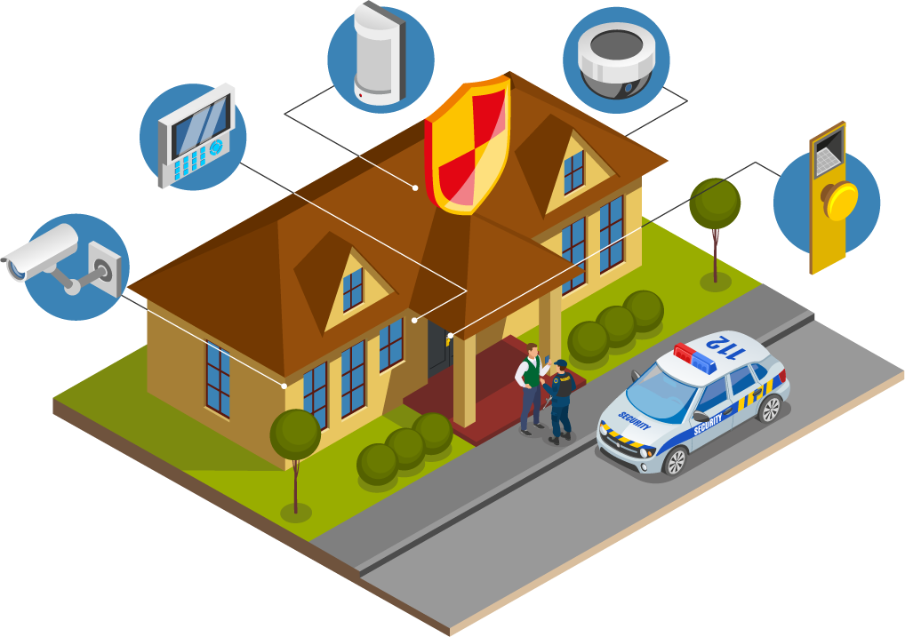

System Analysis And Design
Residential Security
Monitoring System
Presentation
UNIVERSITY OF ASIA PACIFIC
Department Of CSE Course Code: 306

Slide 3





Instructor
Muhtasim Noor Alif
Team Members
Maria Akter Khushi
21201107
Ritu Rani Banik
21201108
Jannatul Ferdousi
21201114
Nur Habibah Binte Mahbub
21201103

Slide 4
Contents:
1
2
3
System Requirement Specification
Development Methodology
Project Scheduling (CPM)

Slide 5

Why we need Residential Security Systems?
Residential Security systems provide exact identification of individuals and vehicles, allowing for focused security measures and effective monitoring. A centralized database collects data from multiple surveillance sources, allowing for extensive data management and analysis. This consolidated method streamlines monitoring and response operations via a central center, allowing for faster action and better coordination between security staff and law enforcement agencies. Together, these devices improve residential security, resulting in a safer environment for occupants than CCTV Camera.
What we need to implement this system?
Surveillance cameras
Facial recognition modules
plate recognition modules
Cargo inspection devices
Centralized database
Central monitoring hub

Slide 6

System Requirement Specification

Slide 7
Functional Requirements
Introduction
Alarm System
01
The Residential Security Monitoring System is designed to provide homeowners with an effective means of monitoring and securing their properties.
04
The system shall be equipped with an alarm system to alert homeowners of potential security threats.
Sensor Integration
User Interface
02
The system shall support integration with various sensors such as motion sensors, door/window sensors, smoke detectors, and glass break detectors.
05
The system shall feature a user-friendly interface accessible via web and mobile applications.
Camera Surveillance
System Administration
03
The system shall include camera surveillance capabilities to provide visual monitoring of the premises.
06
The system shall provide administrative functionalities for configuring sensors, cameras, and user settings.

Slide 8
Non-Functional Requirements
Reliability
Security
The system should have a high level of reliability to ensure continuous monitoring and timely response to security events.
The system should implement robust security measures to prevent unauthorized access to sensitive data.
Availability
Compliance
Ensure that the monitoring system can handle a large number of simultaneous users or devices.
The system should comply with relevant privacy regulations and standards.
Performance
Maintainability
It should be able to handle a large volume of data, such as video feeds, without compromising performance.
The system should be easy to maintain and update, with minimal disruption to ongoing monitoring activities.
Usability
Integration with Emergency Services
The user interface should be intuitive and user-friendly for both homeowners and security personnel.
The system should have the capability to integrate with local emergency services for rapid response to security incidents..

Slide 9

Development Methodology

Slide 10

Development Methodology
1
Requirements
Gathering and Analysis:
Identify stakeholders.
Gather and analyze requirements.
2
System Design:
Design architecture, database, UI/UX,
and security.
3
Implementation:
Select technologies.
Develop core features.
Integrate components.
Implement security measures.

Slide 11
Development Methodology
4
Testing:
5
Deployment:
Unit testing.
Integration testing.
Security testing.
User acceptance testing (UAT).
Prepare deployment environment.
Deploy system components.
Configure system settings.
Train users.
6
Maintenance and
Support:
7
Iterative Improvement:
Monitor system performance.
Apply updates and patches.
Provide technical support.
Gather feedback.
Collect feedback.
Prioritize enhancements.
Iterate and enhance.

Slide 12

Project Scheduling (CPM)

Slide 13
Project Data
Activity serial | Activity | Preceding Activity | Duration
A | Requirements Gathering | - | 2 weeks
B | Planning | A | 3 weeks
C | Development And Testing | B | 6 weeks
D | Review and Feedback | C | 4 weeks
E | Continuous Integration and Deployment | D | 1 week
F | Documentation and Knowledge Sharing | E | 5 weeks
G | Retrospective and Continuous Improvement | F | 2 weeks

Slide 14
Critical Path (CPM):
0
0
0
0
C | 5 | 11
6 | 5 | 11
D | 11 | 15
4 | 11 | 15
E | 15 | 16
1 | 15 | 16
F | 16 | 21
5 | 16 | 21
0
B | 2 | 5
3 | 2 | 5
0
G | 21 | 23
2 | 21 | 23
0
A | 0 | 2
2 | 0 | 2
0
Critical Path:
Critical Path Duration:
A-> B-> C -> D -> E-> F -> G
2+3+6+4+1+5+2= 23 weeks

Slide 15
Forward, Backward pass & Critical Path Calculation
The critical path is A–B–C–D–E–F with a completion time of 21 weeks.
Activity | Duration | ES | EF | LS | LF | Slack
Requirements Gathering | 2 weeks | 0 | 2 | 0 | 2 | 0
System Design | 3 weeks | 2 | 5 | 2 | 5 | 0
Implementation | 6 weeks | 5 | 11 | 5 | 11 | 0
Testing | 4 weeks | 11 | 15 | 11 | 15 | 0
Deployment | 1 weeks | 15 | 16 | 15 | 16 | 0
Maintenance and Support | 5 weeks | 16 | 21 | 16 | 21 | 0

Slide 16
Thank You…….

